Slide 1
Machine Learning and Amazon AI Toolkit
Overview and Live Demos
Balys Kriksciunas Customer Data Engineer

Slide 2
Talk Agenda
What is Machine Learning?
AWS Machine Learning tool
Live Demo
What is Deep Learning?
AWS Deep Learning tools (Polly, Rekognition)
Live Demo

Slide 3
What is Machine Learning?
Definition
Method Classification
"The science of getting computers to act without being explicitly programmed"
Supervised Learning
Unsupervised Learning
Semi-Supervised Learning (Reinforced learning, Deep learning)

Slide 4
ML Problem types
Classification
Regression
Recommenders
Clustering
Anomaly Detection

Slide 5
Problem solving process flow
1. Classify your ML problem (e.g. Supervised learning)
2. Get a list of specific tasks you want to solve (Flag spam e-mails)
3. Define a performance metric (number of false positives)
4. Define problem experience (your initial database of e-mails)
Steps 1,2 are easy
Step 3 you may need to make assumptions (its ok to raise a theory and prove yourself right or wrong later on)
Step 4 you may need to ’clean’ or ‘litter’ the data.

Slide 6
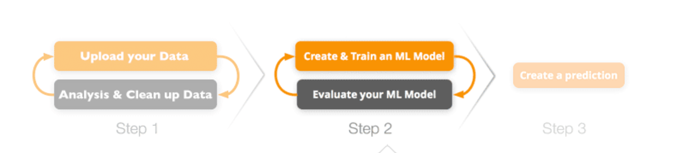

AWS Machine Learning process flow

Slide 7
AWS Machine Learning Demo

Slide 8
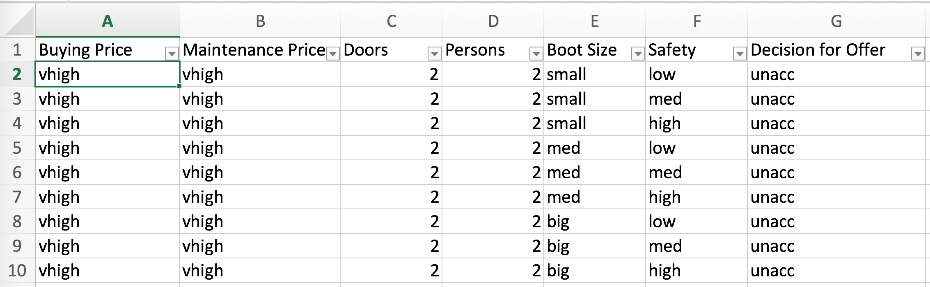
My ML model Data

Slide 9
What is Deep Learning?
Deep learning is a ML branch, using multiple hidden layers in an artificial neural network. This approach tries to model the way the human brain processes light and sound into vision and hearing.

Slide 10
How does our brain see it?

Slide 11
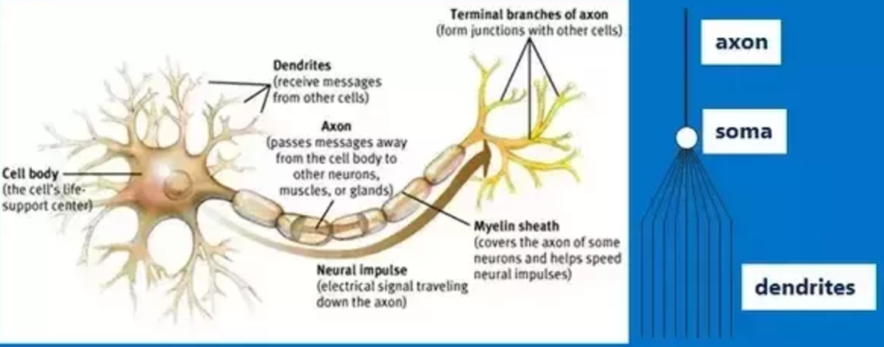
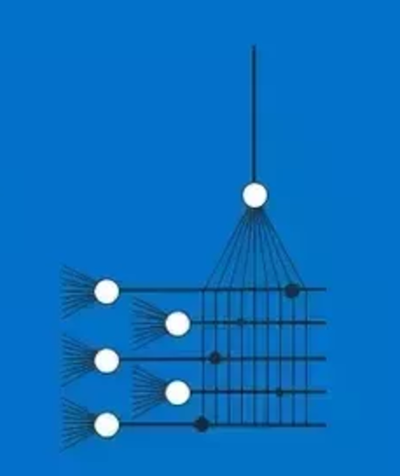
Anatomy of a Neuron and Synapse

Slide 12
How does it represent in DL neural net?

Slide 13
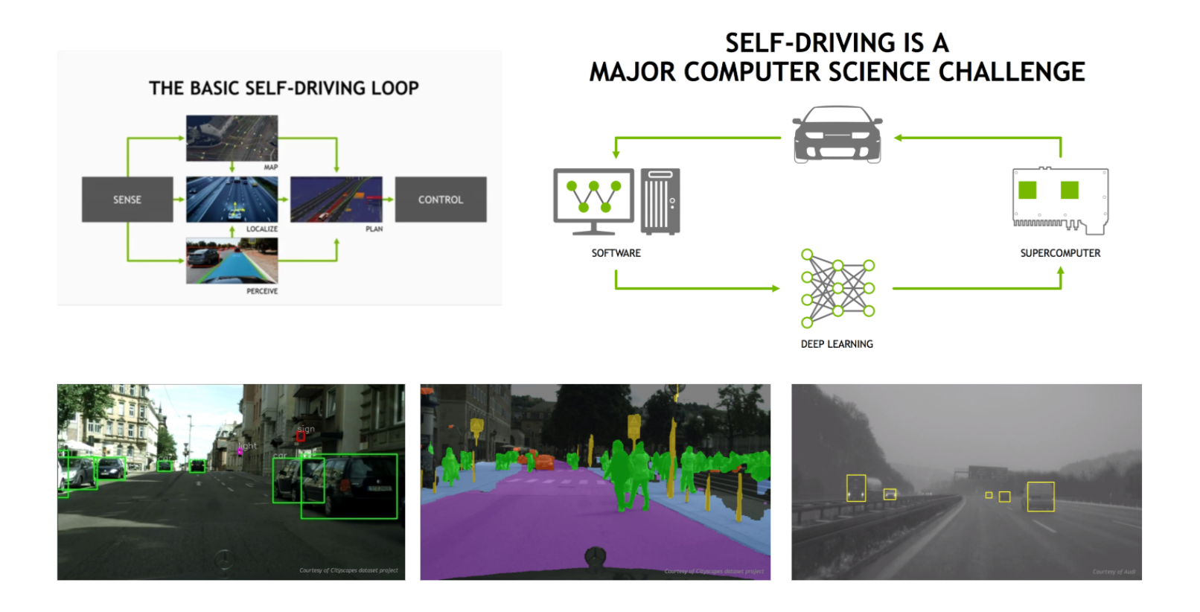
Self driving car example
https://www.youtube.com/watch?v=YuyT2SDcYrU&feature=youtu.be&t=99

Slide 14
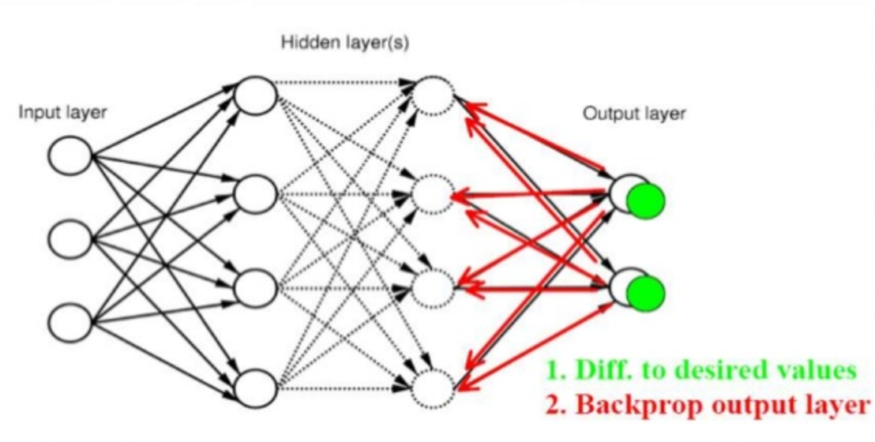
Functional details
The essence of learning in deep learning is nothing more than adjusting a model’s weights in response to the error it produces, until you can’t reduce the error any more (calculate derivative).
Since the functions at all layers are mostly non-linear we cannot use direct derivative algorithms. Few main techniques are used (some in conjunction)
stochastic gradient descent (SGD) or L-BFGS and Backpropagation.

Slide 15
Overfitting and Underfitting
Be mindful when selecting parameters for your deep learning algorithm
(basically, for your function).
If the model is under fitting or overfitting your features it will not make good future predictions.

Slide 16
Deep Learning needs Big Data
But You don’t necessarily need to have the data, sometimes you can invent data yourself too.
For example, add random blur to your image database, crop the images, resize, distort, etc.

Slide 17
AWS Rekognition
Amazon Rekognition is a service that makes it easy to add image analysis to your applications. With Rekognition, you can detect objects, scenes, and faces in images. You can also search and compare faces. Rekognition’s API enables you to quickly add sophisticated deep learning-based visual search and image classification to your applications.

Slide 18
Some Rekognition facts
Fully Managed Deep Learning Model for Image recognition (most likely CNN + Reinforced learning pipeline), trained on Prime photos.
Supports PNG and JPG (up to 15MB via S3, 5MB in upload mode)
Smallest object/face present in the image should be at least 5% of the size (in pixels) of the shorter image dimension (you may need to crop)
US East (Northern Virginia), US West (Oregon) and EU (Ireland) regions
Has lots of embedded labels for object recognition (e.g. Rose, Airplane..)
Can match certainty and label on 11 facial expressions (smile, beard, emotions)
Detects up to 15 faces in image
Charges per API usage, $0.01 per 1,000 face vectors calls
Integrated with Lambda for trigger-based pipelines

Slide 19
AWS Polly
Amazon Polly is a service that turns text into lifelike speech.
Boring, but useful product.
Includes 47 voices and 24 languages
You can control various aspects of speech such as pronunciation, volume, pitch, speech rate, etc.
Use cases:
Smart house (building your own JARVIS)
intelligent call-center apps
translation apps

Slide 20
AWS Deep Learning Demo

Slide 21
Some documentation
https://boto3.readthedocs.io/en/latest/reference/services/rekognition.html
Polly: http://docs.aws.amazon.com/polly/latest/dg/what-is.html
Rekognition: http://docs.aws.amazon.com/rekognition/latest/dg/what-is.html
AWS Machine learning: https://aws.amazon.com/machine-learning
Deep Learning: http://machinelearningmastery.com/start-here/
Machine learning datasets:
http://www.datasciencecentral.com/profiles/blogs/13-machine-learning-data-set-collections
https://ocw.mit.edu/courses/sloan-school-of-management/15-097-prediction-machine-learning-and-statistics-spring-2012/datasets/ https://en.wikipedia.org/wiki/Stochastic_gradient_descent
All presentation details / code on github:
https://github.com/balys/awsai-presentation

Slide 22
Thank you

